Slide 1

Practical Research
Planning and Design
Tenth Edition
Original Presentation By:
Paul D. Leedy
Jeanne Ellis Ormrod
Modified and Enhanced By:
Yun Zhang
Tahmina Ahmed
Prosunjit Biswas
© 2013, 2010, 2005, 2001, 1997
Pearson Education, Inc. All rights reserved.

Slide 2






Six Tools of Research
The library and its resources Computer technology
Measurement Statistics
The
Language Human Mind
1-1

Slide 3

Reasoning Tools for Research
Critical Thinking
Deductive Logic
Inductive Reasoning
The Scientific Method
Theory Building
1-2

Slide 4

Critical Thinking
Components of Critical Thinking:
- verbal reasoning
- argument analysis
- decision making
- critical analysis of prior research
Ask Questions….:
-What does it mean ?
-What does it mean to others?
- What are examples / use-cases?
- How does this apply to real life?
- and so on.
1-3

Slide 5
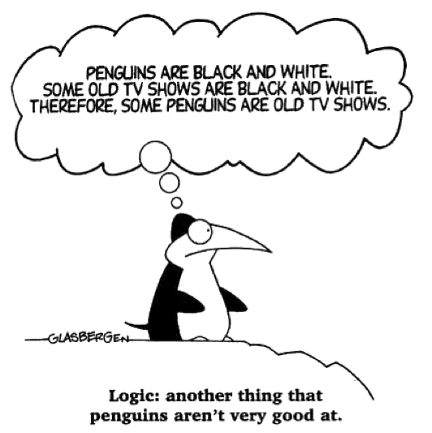


Deductive Logic
Given one or more premises which is taken to be true. Conclusion or decision is being made logically from this premises.
1-4

Slide 6
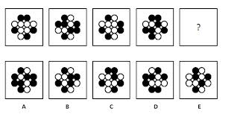
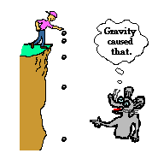
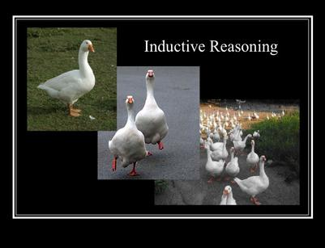
Inductive Reasoning
reasoning from detailed facts to general principles. Also called “bottom up” reasoning.
1-5

Slide 7
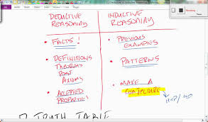
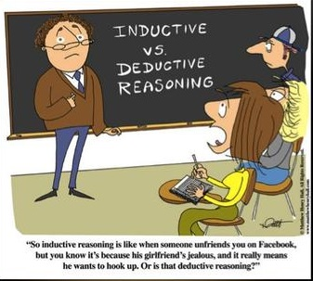
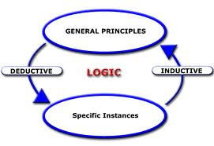
Inductive vs Deductive Reasoning
1-6

Slide 8
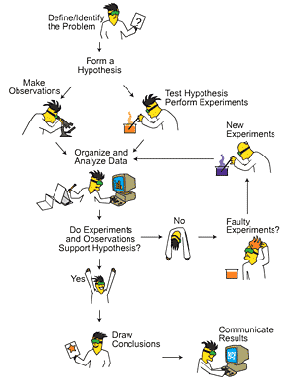
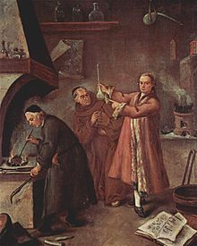
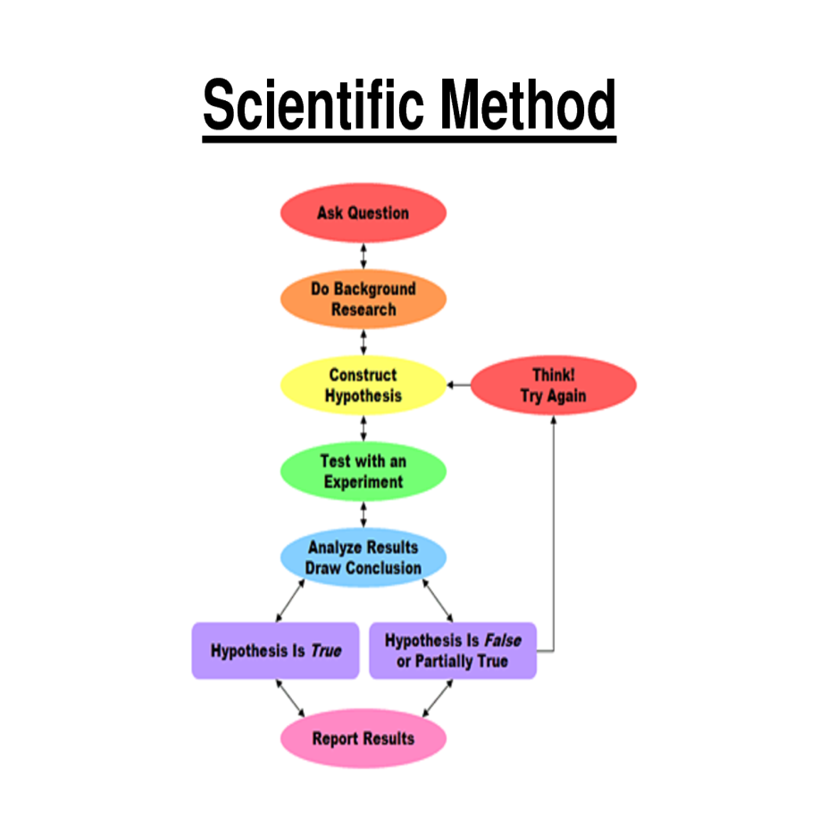
The Scientific Method:
The scientific method is a set of techniques for investigating phenomena, acquiring new knowledge, or correcting and integrating previous knowledge
1-7

Slide 9
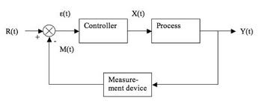
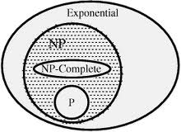
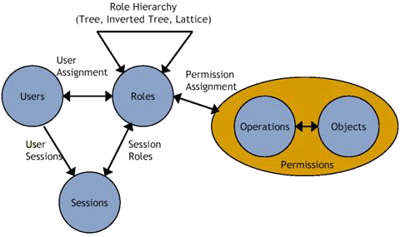

Theory Building
Theory Building is people making sense of the world around them. We all do it all the time. Kids build theory about where they come from.
1-8

Slide 10
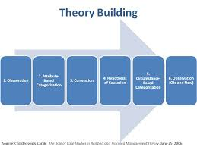
Theory Building Continuing…
What it takes to build a theory?
Steps:
1. Observe
2. Organize
3. Find Co-relation
4. Create hypothesis
5. Justify Hypothesis
6. Build Model
1-9

Slide 11

Human Mind as Tools of Research
Can We make a system to make automatic decision (and correct one) ?
What about reasoning under uncertainty?
Eventually, it is you who decide.
1-10

Slide 12

Collaboration
“If you want to go fast, go alone. If you want to go far, go together.”
What is collaboration?
Who to Collaborate with?
bet^{n} Individuals
bet^{n} Groups
Industry vs Institution
and so on…
Example:
IBM University Research and Collaboration
Through Intern, Fellowship, grant etc.
1-11

Slide 13
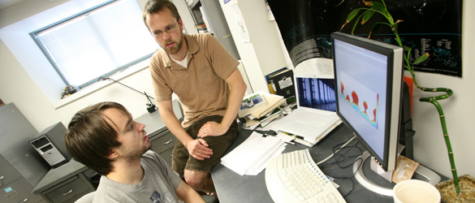
How to Collaborate as a PhD Student
Be open
-Discuss what you are doing and what others doing.
Participation in discussion groups
Find Collaborator
Collaboration with Friends or Lab-mates
Collaboration with Friends at other university
Keep looking
-Internship/ Fellowship
-Industry leader / researcher
Maintain Network
ResearchGate
LinkedIn
Any Idea ?
1-12

Slide 14

Exploring Research in Your Field
Keeping an eye on
-Conferences / Workshops
Industry work
Other researchers
Industry Whitepapers
Blogs / Magazine
1-13

Slide 15


